Slide 1

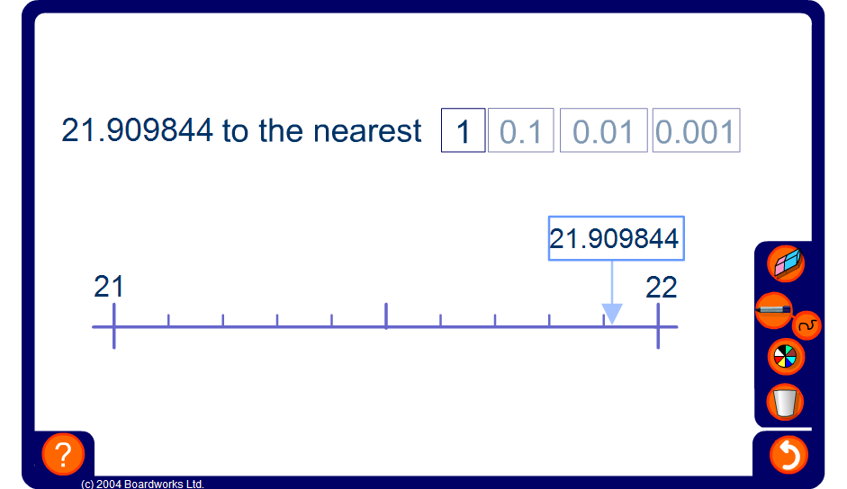


Rounding decimals
Notes:
This activity illustrates the rounding of decimal numbers on a number line to the nearest given power of 10, for example to the nearest 0.1, 0.001 or 0.0001. Extend the activity by asking pupils to determine the values of the two end-points before revealing them and then predict where the given value will be on the number line.

